Slide 1
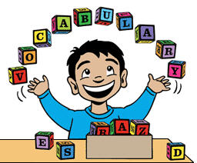
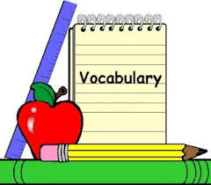
Unit 1 Local environment

Slide 2
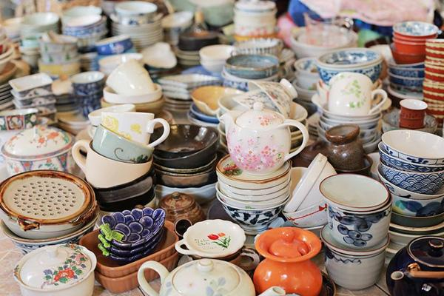
Pottery: đồ gốm

Slide 3
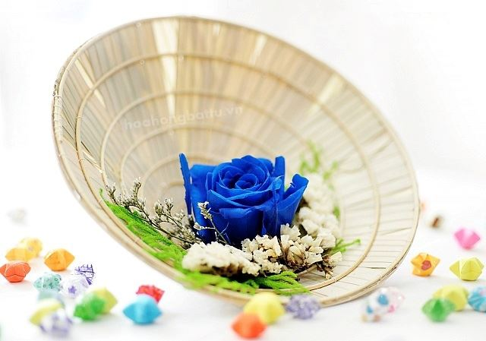
Conical hat : nón lá

Slide 4
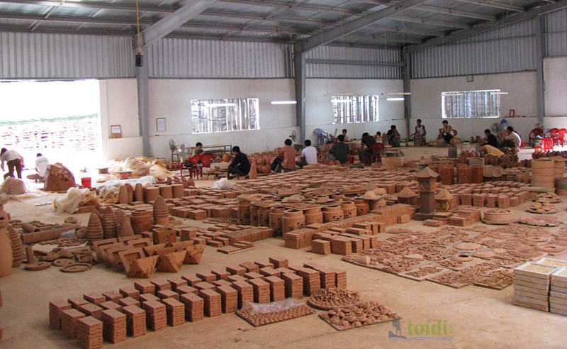
Workshop : xưởng làm việc

Slide 5
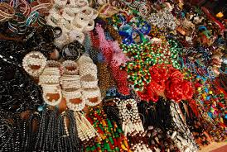
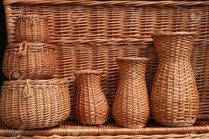
Handicraft : đồ thủ công

Slide 6
Start something ( a business, an organization...) :
Take control of something.
People who do skilled work, making things with their hands.
An interesting or enjoyable place to go or thing to do.
A particular place.
Make someone remember or think about something.
Walk around a place to see what is there.
1. Set up (thành lập)
2. Take over ( tiếp quản)
3. Artisans (nghệ nhân)
4. Attraction (điểm thu hút)
5. Specific region (vùng riêng biệt)
6. Remind (tưởng nhớ)
7. Look around ( đi dạo xung quanh)

Slide 7
I. Vocabulary:
Pottery (n) đồ gốm
Set up (v) thành lập
Workshop (n) xưởng
Take over (v) tiếp quản
Attraction (n) sự thu hút
Conical hat (n) nón lá
Remind (v) tưởng nhớ
Specific region : vùng miền riêng
Handicraft (n) đồ thủ công
Look around (v) đi dạo xung quanh

Slide 8
1. Listen and read:
B.
1. They are at Phong’s grandparents’ workshop in Bat Trang.
2. It is about 700 years old.
3. His great-grandparents did.
4. Because people can buy things for their house and make pottery themselves there.
5. It’s in Hue.
6. Because the handicrafts remind them of a specific region.

Slide 9
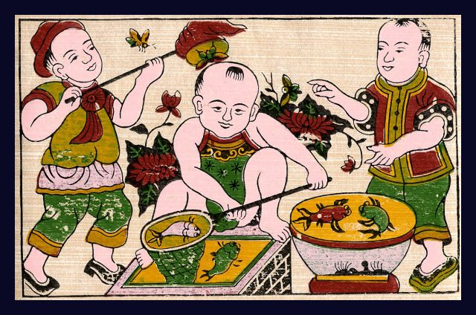
2. Write name of each traditional handicraft in the box under the picture:
1. Paintings : bức tranh

Slide 10
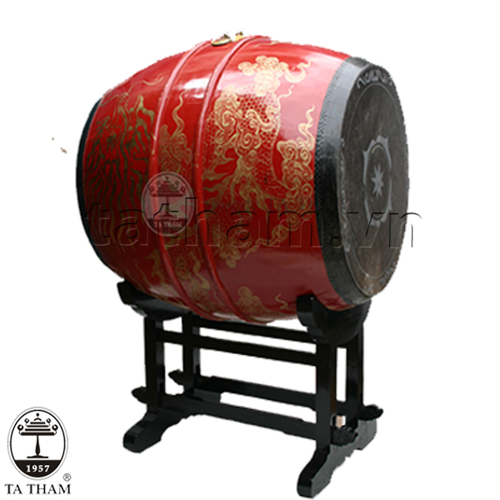
2. Drum : cái trống

Slide 11
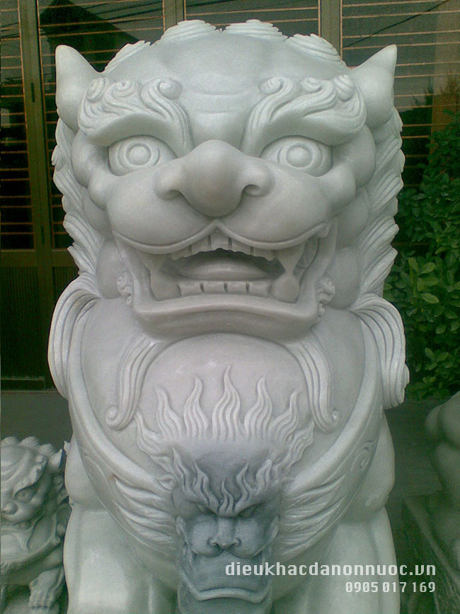
3. Marble sculpture: tác phẩm điêu khắc bằng đá cẩm thạch

Slide 12
4. Pottery : đồ gốm

Slide 13
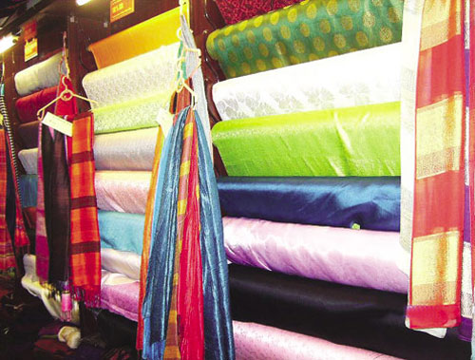
5. Silk : lụa

Slide 14
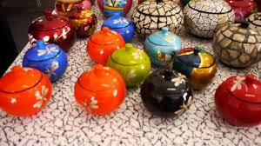
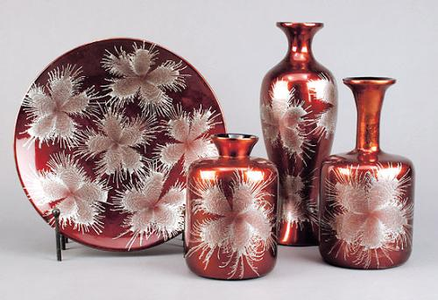
6. Lacquerware : sơn mài

Slide 15
7. Conical hat

Slide 16
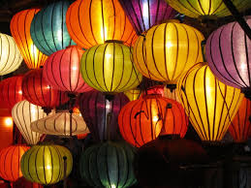
8. Lantern : lồng đèn

Slide 17
A closer look 1
Carve (v) khắc, tạc, đục
Cast (v) đổ khuôn (nóng chảy)
Weave (v) dệt, đan
Embroider (v) thêu
Knit (v) đan (len)
Mould (v) tạo khuôn

Slide 18
Pronunciation: Stress on content words
The craft village lies on the river bank.
This painting is embroidered.
What is this region famous for?
Drums aren’t made in my village.
A famous artisan carved this table beautifully.

Slide 19
Stressed:
Noun :house, teacher…
Verb : go, walk, …
Adj, adv : big, historic…
Wh: what, how…
Negative : isn’t, don’t…
Unstressed:
Article: a, an, the
Preposition : in , on, at…
Pronoun : I, you, we…
Possessive adj : his, her, my….

